Slide 1
Template for
Research Category
Blue Background

Slide 2
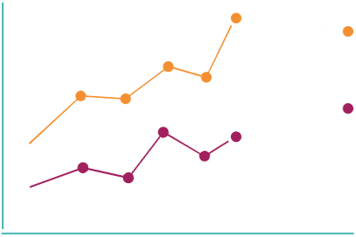
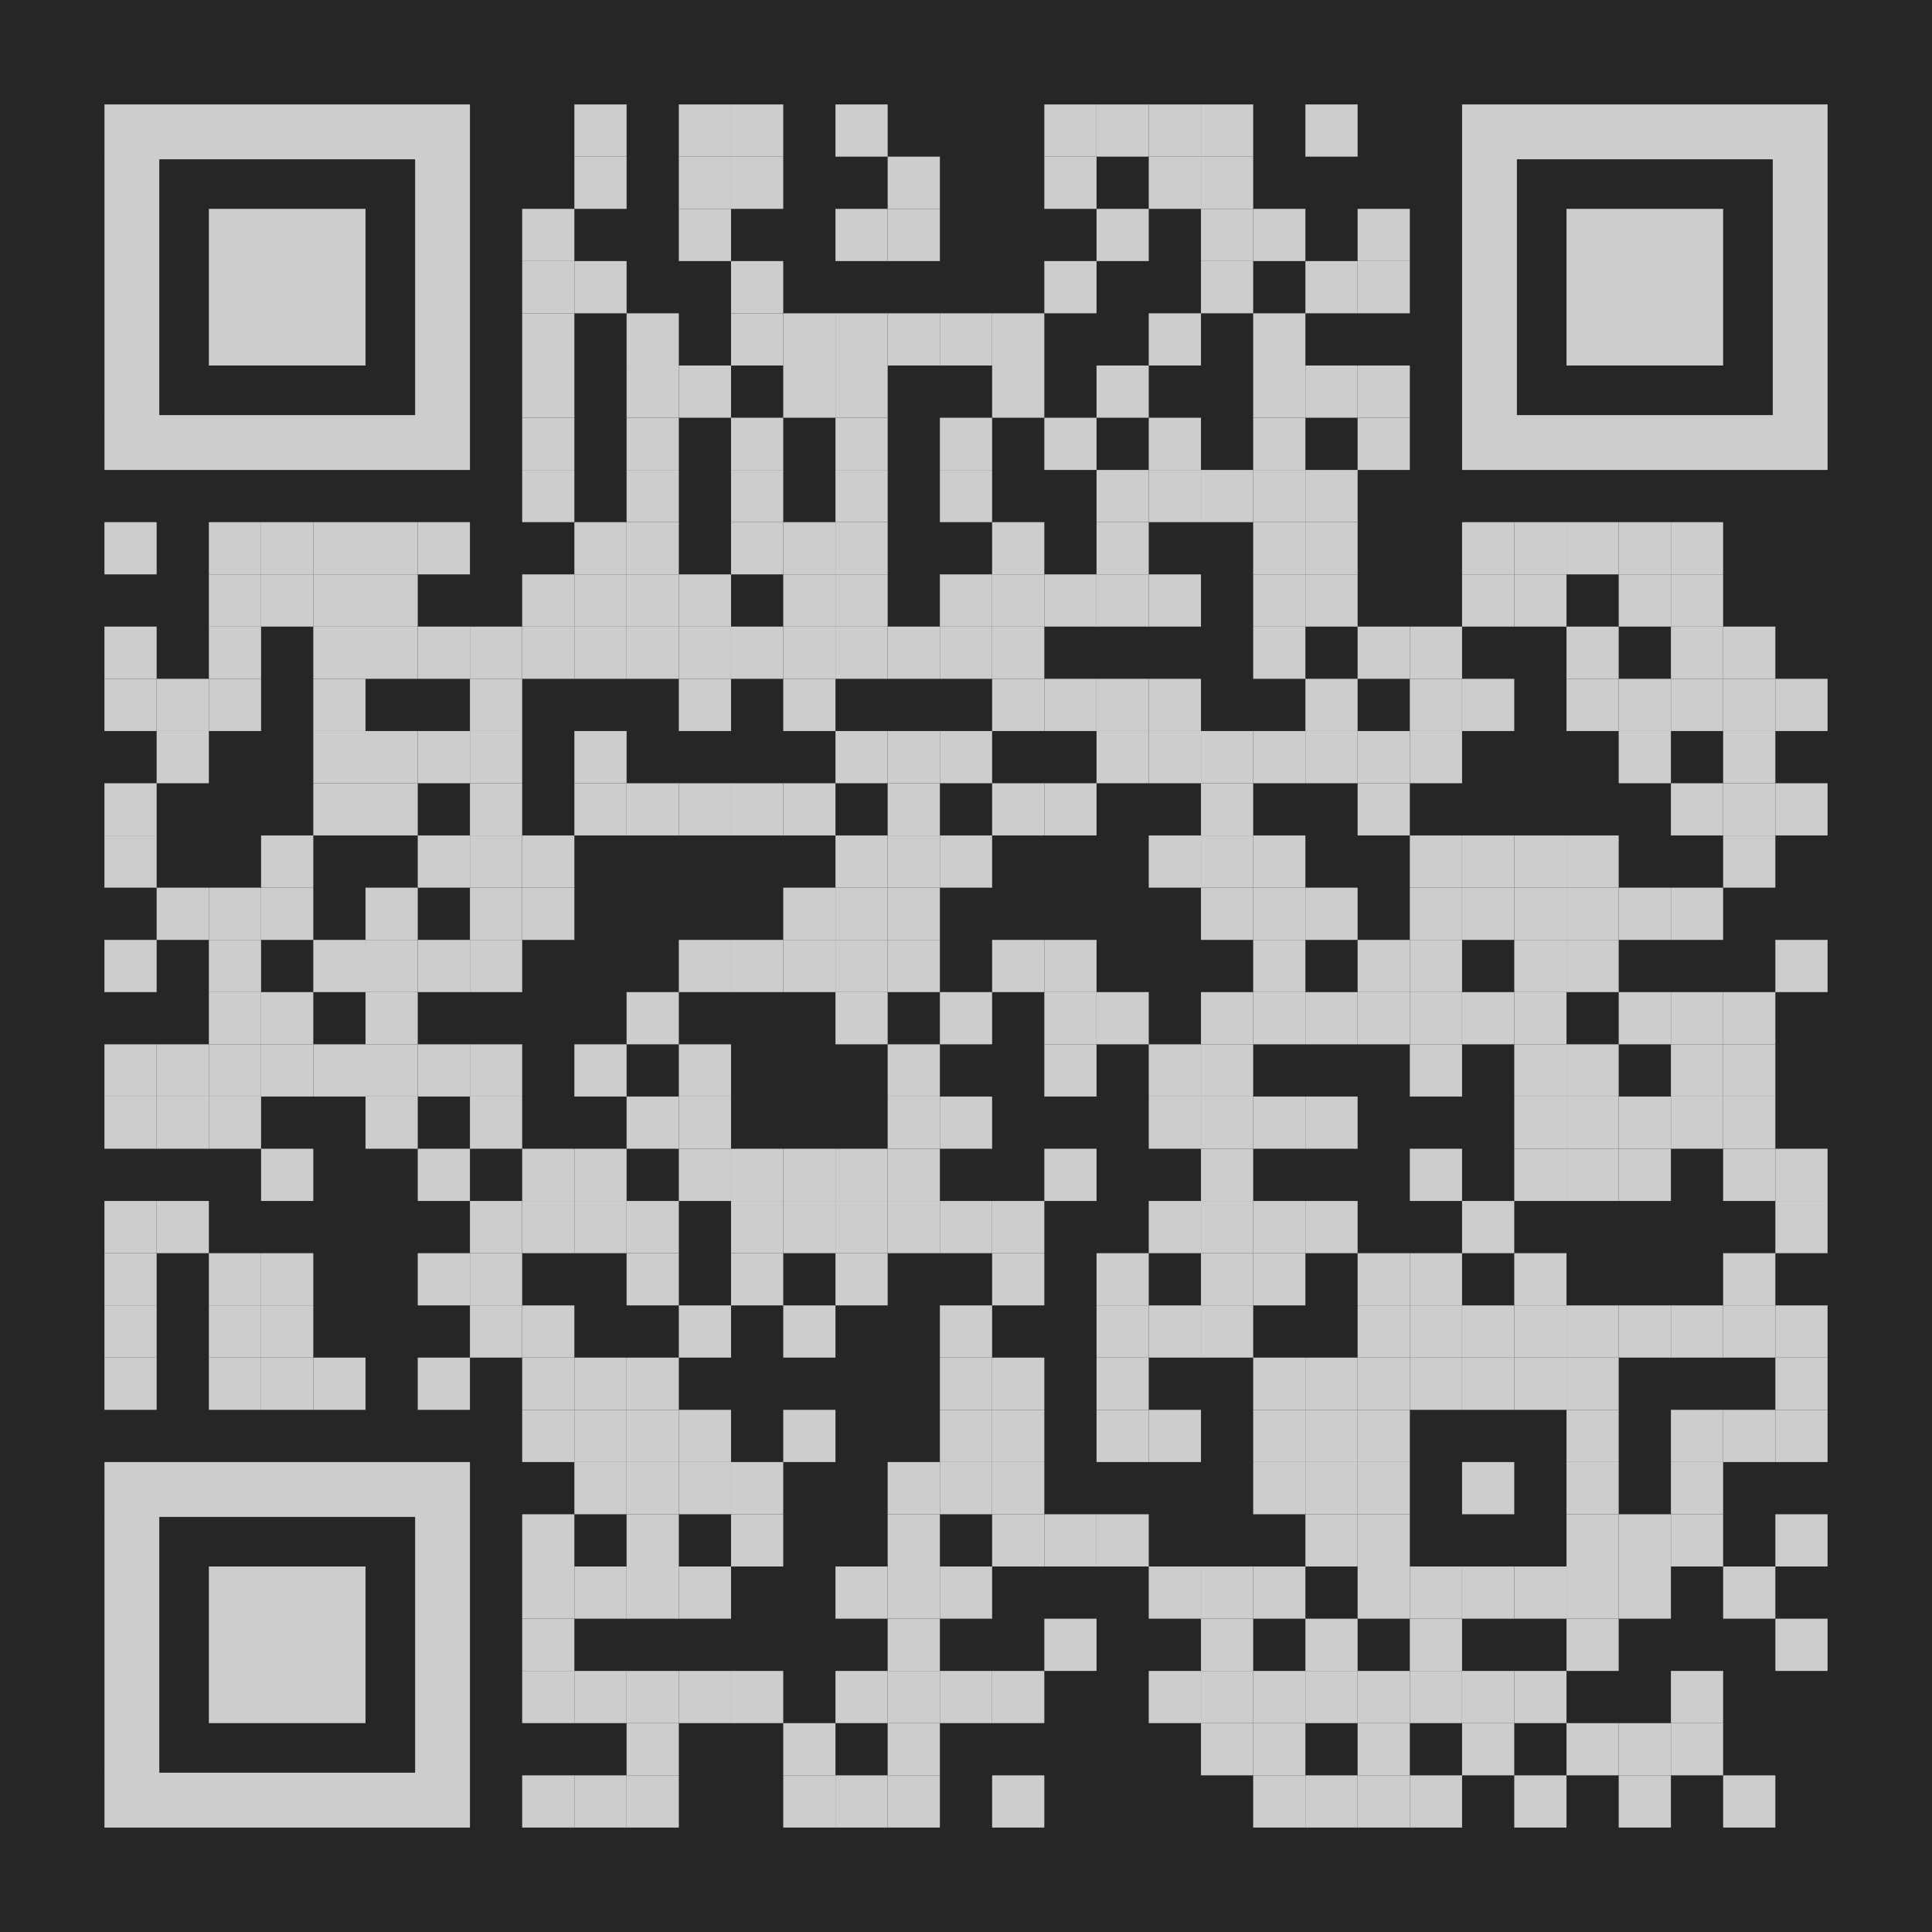
Main finding goes here, translated into plain English. Emphasize the important words by bolding them.
Title: Subtitle
AMMO BAR
Delete this and replace it with your…
Extra Graphs
Extra Correlation tables
Extra Figures
Extra nuance that you’re worried about leaving out.
PRESENTER:
Leeroy Jenkins
INTRO:
Explain why your study matters in the fastest way
Why should they care?
METHODS:
Collected [what] from [population]
Tested it with X process.
Illustrate your methods if you can.
RESULTS
List the key results of the study
Only include graphics/tables that include essential results
All the other correlations in the ammo bar
DISCUSSSION:
Include any possible implications in other areas of study
Include any possible improvements that can be made in order to further develop the concerns of your research
Visualize your findings with an image, graphic, product, or a key figure.
Leeroy Jenkins, author2, author3, author4, author5, author6, author7, author42
Take a picture to download the full paper
Notes:
FORMATTING:
In PowerPoint, click View > Guides
Keep text within gutter guides.
MAIN FINDINGS BAR (middle):
This bar highlights the key finding from your study, in plain language
Also include a QR code on where to go for more information (information on how to include and download a QR code is on slide 5)
NOTES:
If your main finding “punchline” is more than 2 lines, don’t center it. Centering makes the reader’s eyes do more work and is slower to read than left-aligned text.
SILENT PRESENTER BAR (left):
This bar allows poster attendees to read a summary of your study in 1-4 minutes
Include: Title, Subtitle, Author list, Intro, Methods, Results, and Discussion
NOTES:
Don’t split names of authors onto two lines (e.g., “Jimmy [break] Smith”). If that happens, use a new line, unless you need the space. Bold the first names of anybody who’s presenting in person.
Do not drop below font size 28, but if you have extra space, jack up the font size until the space is full.
Do not use color in the sidebars except in graphs/figures. It’ll pull attention from the center and slow interpretation for passersby.
AMMO BAR (right):
This bar lists the graphics, tables, and figures the presenter may need to answer any questions
If a product or tool was produced as a result of the study, you can include a picture of it here or in the main findings column.

Slide 3
Template for
Practice Category
Green Background

Slide 4
Main finding goes here, translated into plain English. Emphasize the important words by bolding them.
Title: Subtitle
AMMO BAR
Delete this and replace it with your…
Extra Graphs
Extra Correlation tables
Extra Figures
Extra nuance that you’re worried about leaving out.
PRESENTER:
Leeroy Jenkins
INTRO:
Explain why your study matters in the fastest way
Why should they care?
METHODS:
Collected [what] from [population]
Tested it with X process.
Illustrate your methods if you can.
RESULTS
List the key results of the study
Only include graphics/tables that include essential results
All the other correlations in the ammo bar
DISCUSSSION:
Include any possible implications in other areas of study
Include any possible improvements that can be made in order to further develop the concerns of your research
Visualize your findings with an image, graphic, product, or a key figure.
Leeroy Jenkins, author2, author3, author4, author5, author6, author7, author42
Take a picture to download the full paper
Notes:
FORMATTING:
In PowerPoint, click View > Guides
Keep text within gutter guides.
MAIN FINDINGS BAR (middle):
This bar highlights the key finding from your study, in plain language
Also include a QR code on where to go for more information (information on how to include and download a QR code is on slide 5)
NOTES:
If your main finding “punchline” is more than 2 lines, don’t center it. Centering makes the reader’s eyes do more work and is slower to read than left-aligned text.
SILENT PRESENTER BAR (left):
This bar allows poster attendees to read a summary of your study in 1-4 minutes
Include: Title, Subtitle, Author list, Intro, Methods, Results, and Discussion
NOTES:
Don’t split names of authors onto two lines (e.g., “Jimmy [break] Smith”). If that happens, use a new line, unless you need the space. Bold the first names of anybody who’s presenting in person.
Do not drop below font size 28, but if you have extra space, jack up the font size until the space is full.
Do not use color in the sidebars except in graphs/figures. It’ll pull attention from the center and slow interpretation for passersby.
AMMO BAR (right):
This bar lists the graphics, tables, and figures the presenter may need to answer any questions
If a product or tool was produced as a result of the study, you can include a picture of it here or in the main findings column.

Slide 5
Template for
‘Other’ Category
Purple Background

Slide 6
Main finding goes here, translated into plain English. Emphasize the important words by bolding them.
Title: Subtitle
AMMO BAR
Delete this and replace it with your…
Extra Graphs
Extra Correlation tables
Extra Figures
Extra nuance that you’re worried about leaving out.
PRESENTER:
Leeroy Jenkins
INTRO:
Explain why your study matters in the fastest way
Why should they care?
METHODS:
Collected [what] from [population]
Tested it with X process.
Illustrate your methods if you can.
RESULTS
List the key results of the study
Only include graphics/tables that include essential results
All the other correlations in the ammo bar
DISCUSSSION:
Include any possible implications in other areas of study
Include any possible improvements that can be made in order to further develop the concerns of your research
Visualize your findings with an image, graphic, product, or a key figure.
Leeroy Jenkins, author2, author3, author4, author5, author6, author7, author42
Take a picture to download the full paper
Notes:
FORMATTING:
In PowerPoint, click View > Guides
Keep text within gutter guides.
MAIN FINDINGS BAR (middle):
This bar highlights the key finding from your study, in plain language
Also include a QR code on where to go for more information (information on how to include and download a QR code is on slide 5)
NOTES:
If your main finding “punchline” is more than 2 lines, don’t center it. Centering makes the reader’s eyes do more work and is slower to read than left-aligned text.
SILENT PRESENTER BAR (left):
This bar allows poster attendees to read a summary of your study in 1-4 minutes
Include: Title, Subtitle, Author list, Intro, Methods, Results, and Discussion
NOTES:
Don’t split names of authors onto two lines (e.g., “Jimmy [break] Smith”). If that happens, use a new line, unless you need the space. Bold the first names of anybody who’s presenting in person.
Do not drop below font size 28, but if you have extra space, jack up the font size until the space is full.
Do not use color in the sidebars except in graphs/figures. It’ll pull attention from the center and slow interpretation for passersby.
AMMO BAR (right):
This bar lists the graphics, tables, and figures the presenter may need to answer any questions
If a product or tool was produced as a result of the study, you can include a picture of it here or in the main findings column.

Slide 7
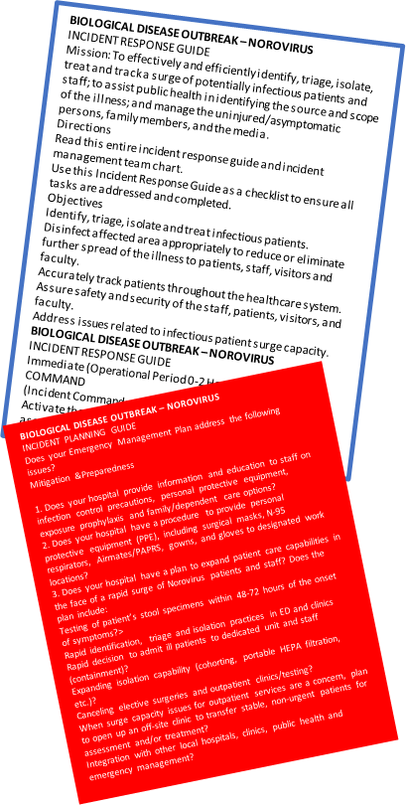
NOROVIRUS Just-in-Time training tool developed to improve response time and efficiency.
Norovirus Outbreak Made Easy? Utilizing incident command tactics for infectious disease outbreak responses
PRESENTER:
Kristine Sanger, BS, MT (ASCP)
INTRO:
Norovirus outbreaks have the ability to result in a surge of communicable patients in healthcare settings.
Just-In-Time (JIT) training materials help prepare responders for various aspects and tasks involved during an infectious disease outbreak response.
METHODS:
Published Hospital Incident Command System (HICS) guides were used to develop just-in-time training materials tailored for norovirus.
RESULTS
A just-in-time training tool tailored for norovirus was developed, including:
A scenario,
An incident planning guide, and
An incident response guide.
Take a picture to download the full paper
Notes:
For the Norovirus JIT training tools referred to in the sample poster, click the links below.
Just in Time Training tool (https://cdn.ymaws.com/www.ahepp.org/resource/resmgr/poster/jitnoro2.pdf)
Incident Planning Guide (https://cdn.ymaws.com/www.ahepp.org/resource/resmgr/poster/noro2.pdf)
Incident Command Chart (https://cdn.ymaws.com/www.ahepp.org/resource/resmgr/poster/noro_chart_all.pdf)

Slide 8
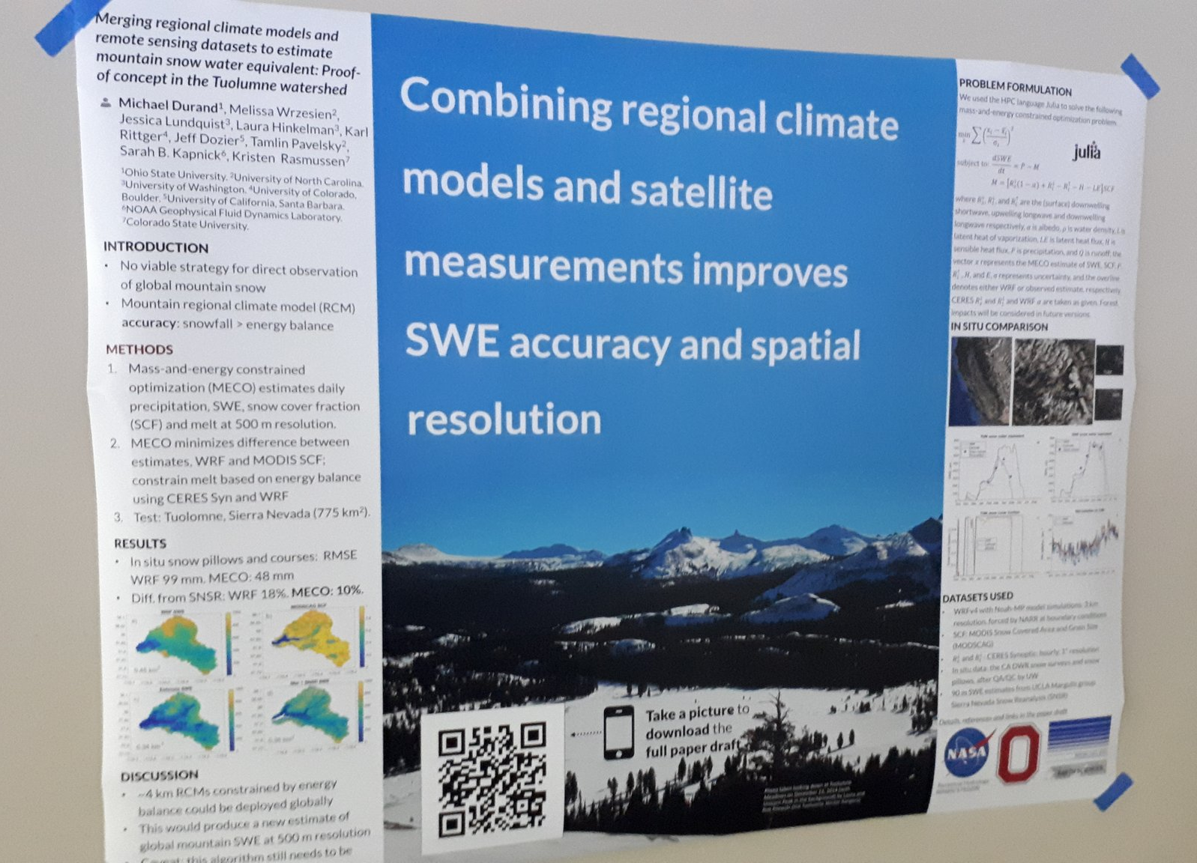
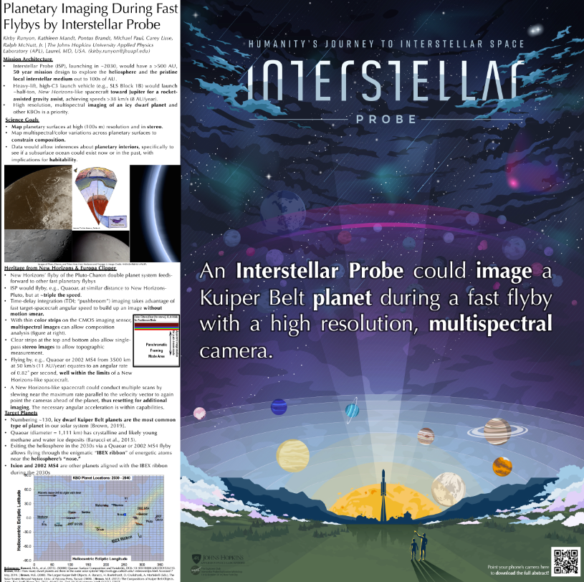
Try an on-theme background. Add fun and reinforce your study’s context, but make sure to keep a high contrast between your text and background!
Example donated by @brenden0walker
Example donated by @hydrogawker
Mountain photo by @mnthydro
Example donated by @nasaman58
vvv
Example donated by @SarraceniaMason
Example donated by @americoamorim
Example by @mikemorrison
Notes:
For additional information on the required format, view the instructional video here: https://www.youtube.com/watch?v=1RwJbhkCA58&feature=youtu.be

Slide 9
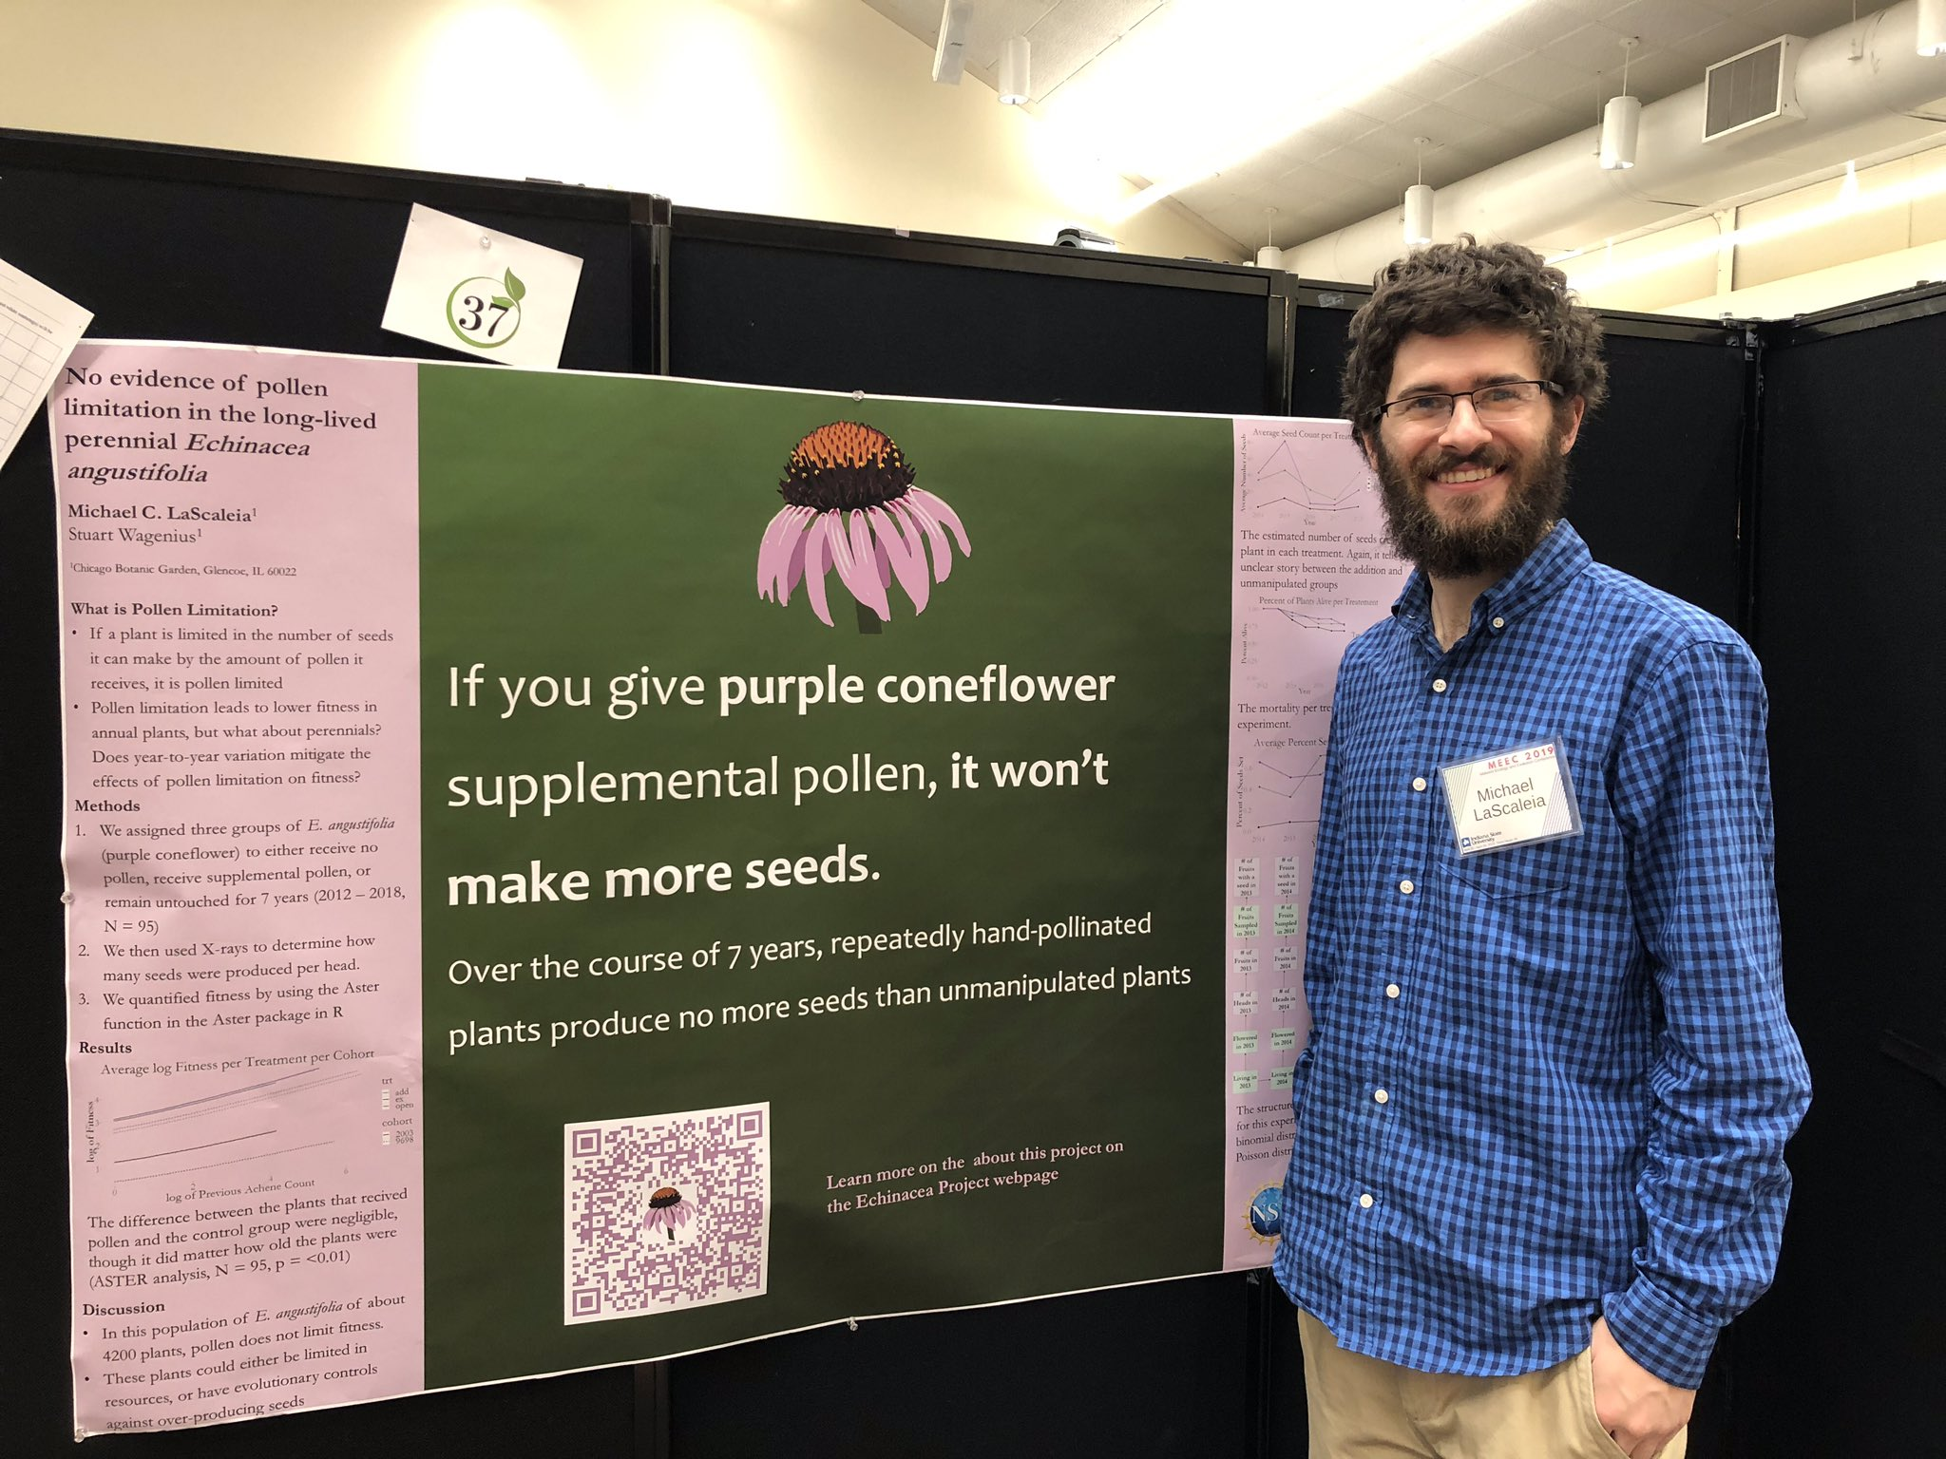
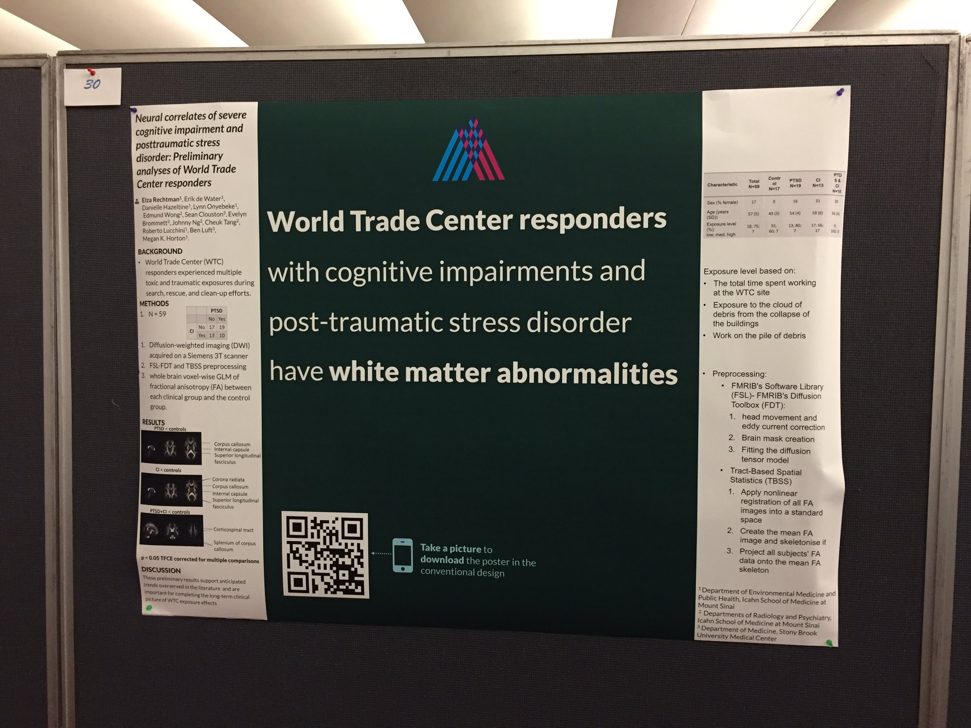
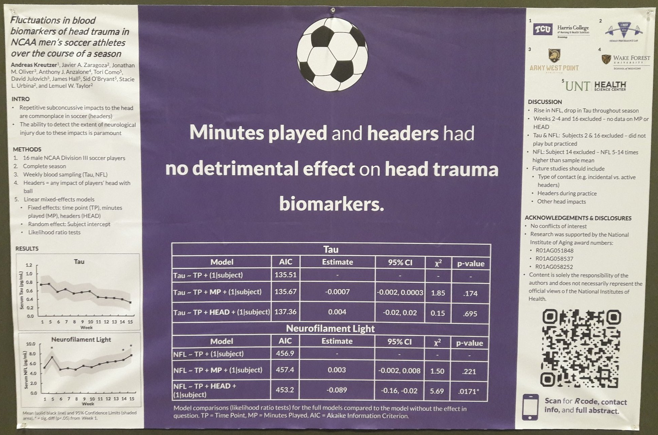
Try a ‘hat’ icon. Imagery, reinforces your finding, makes your poster memorable — and can be interpreted at-a-glance.
Example donated by @MCLaScience
Example donated by @DStroumsa
Example donated by @ElzaRechtman
Example donated by @mikemorrison
Example donated by @akreutzer82

Slide 10
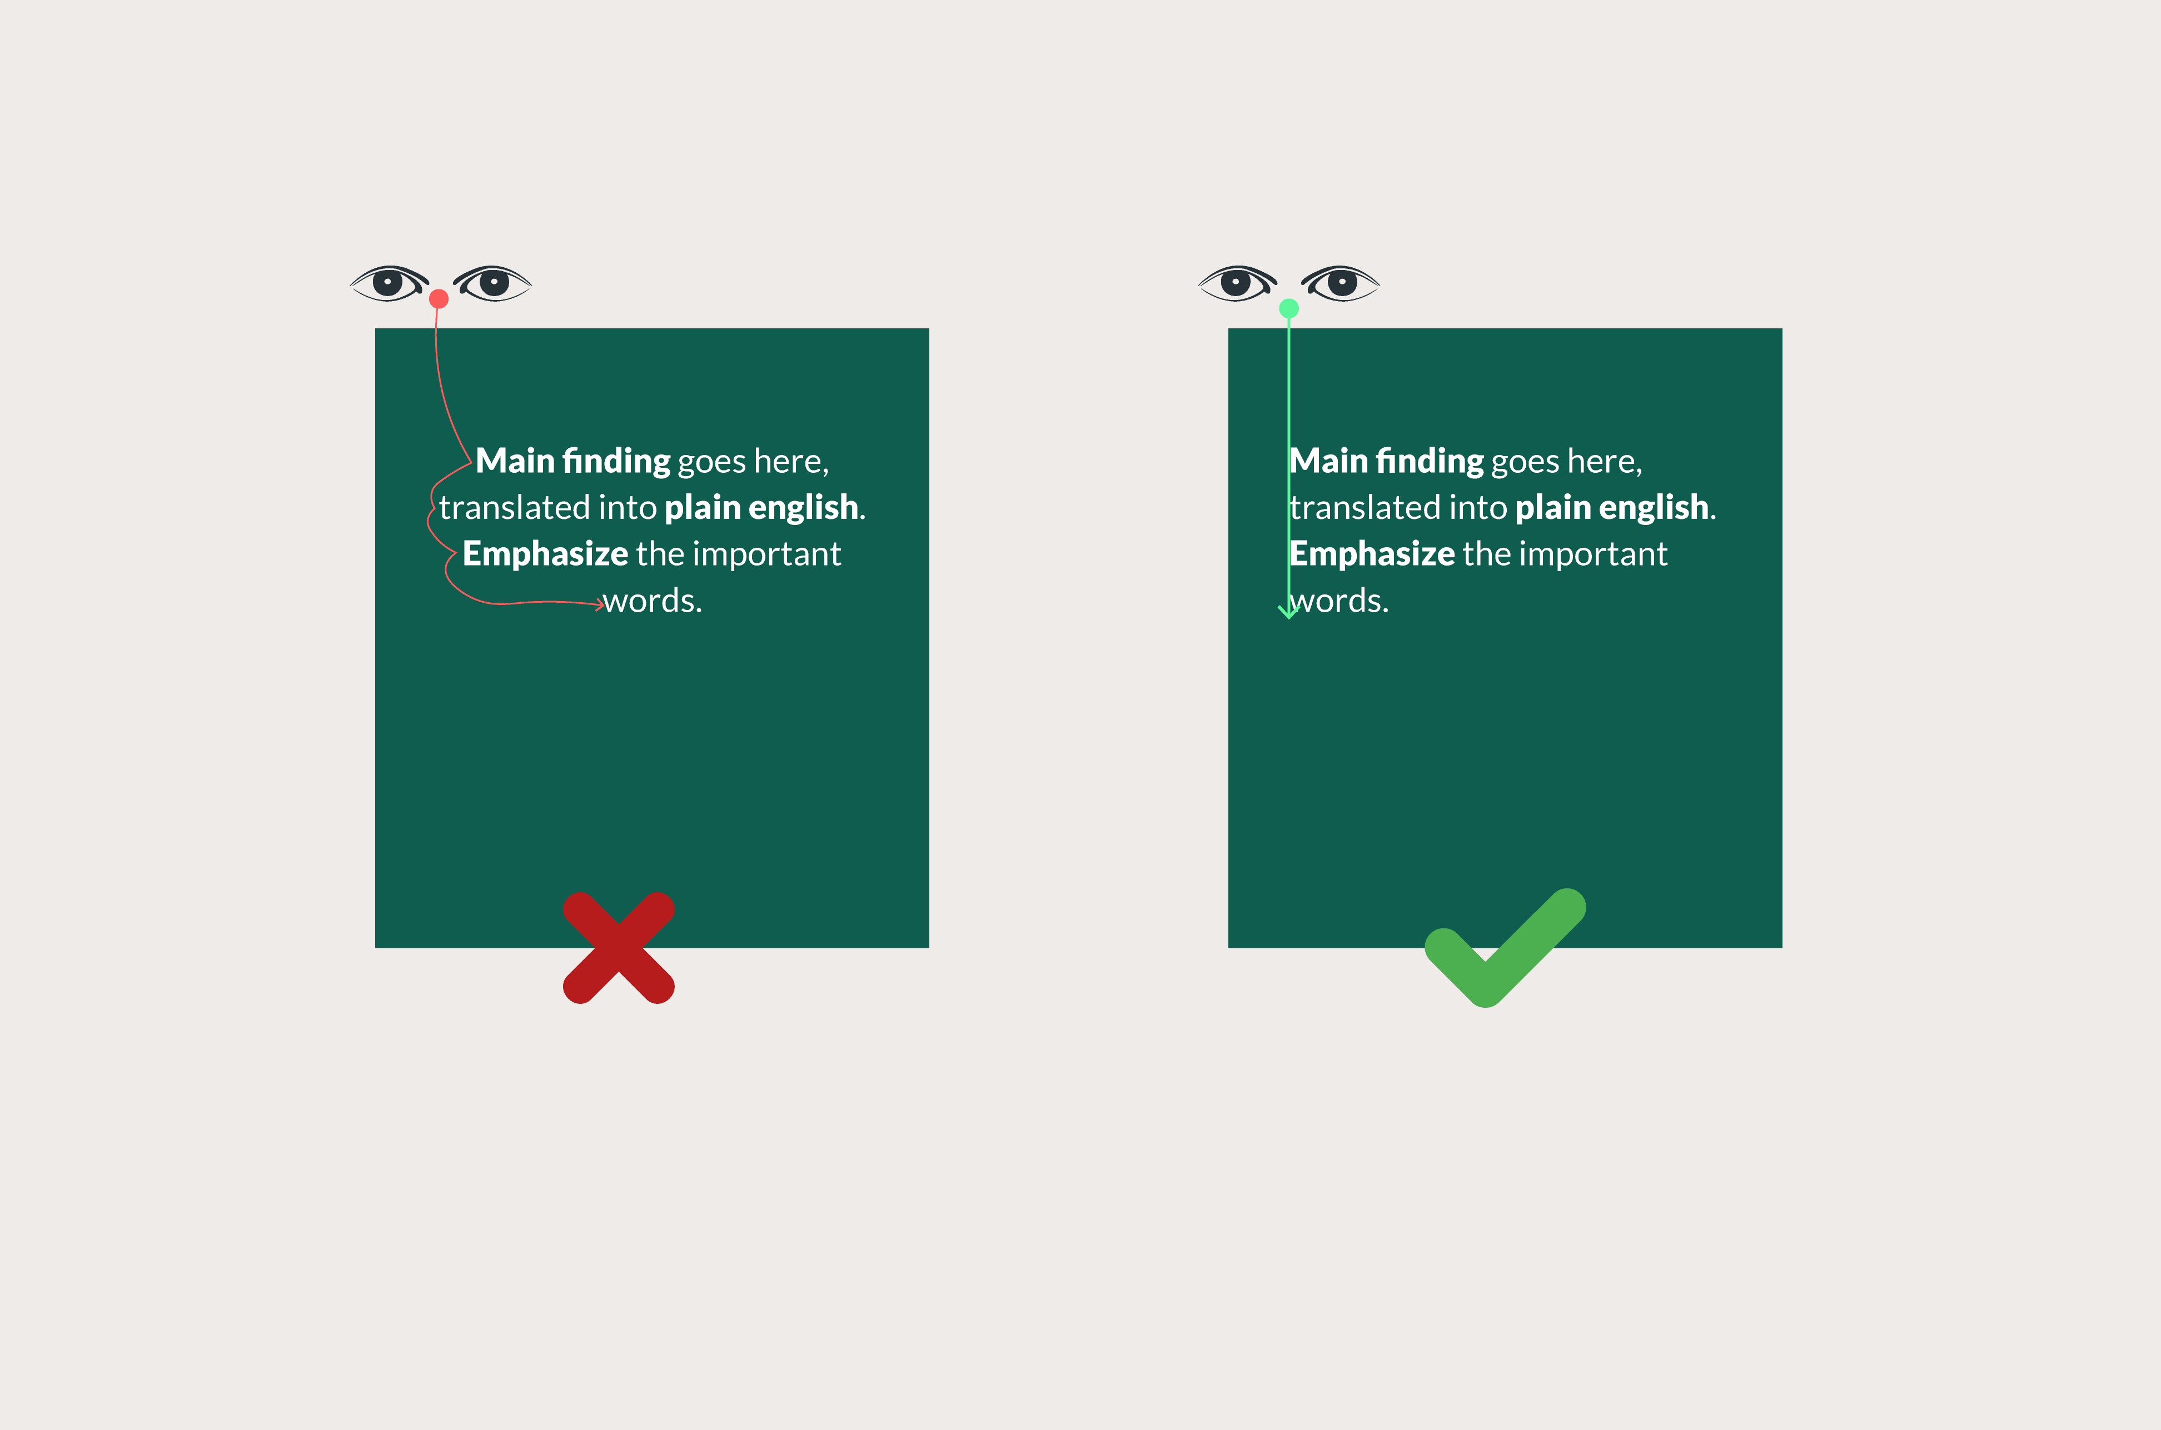
If your main finding “punchline” is more than 2 lines, don’t center it.
Centering makes your eyes do more work, and centered text is slower to read than left-aligned text.

Slide 11
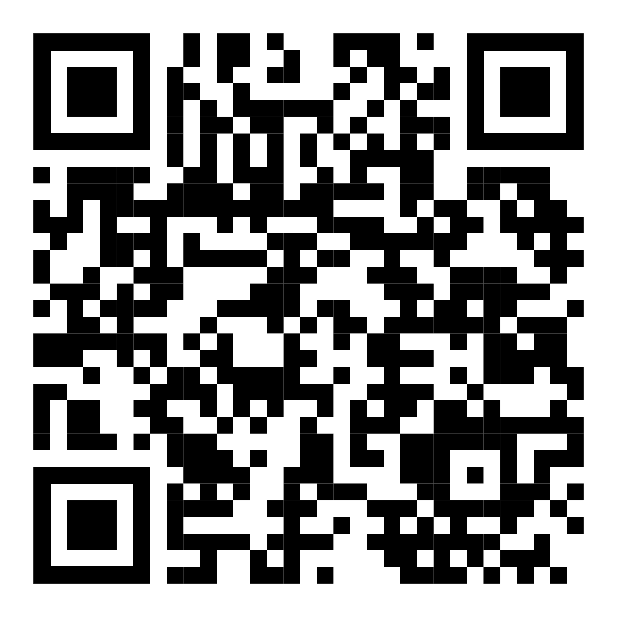
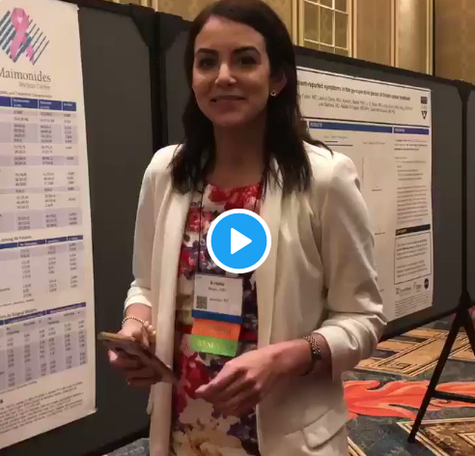
How to QR Code
How do I create a QR code?
https://www.qrcode-monkey.com/ is free, URLs don’t expire, and you can add cool features like images.
How do I scan a QR code?
Just pull out your phone and take a picture! All modern iPhones and most Android phones have built-in QR detection in their cameras. Some Android phones may need an app.
Ctrl-click this thumbnail to watch a video on scanning #betterposter QR codes.
Donated by @kristinrojasmd
https://twitter.com/kristinrojasmd/status/1124418213050298368

Slide 12
Layout F.A.Q.
What if my intro/methods/results doesn’t fit in the silent bar?
If you’re trying to put so much into that bar that it doesn’t fit, they won’t have time to read it anyway. First try moving stuff to the ammo bar. Next, cut, cut, cut.
Instead of trying to fill space, you’re trying to conserve space.
What if I have a really important graph or picture?
Move the QR Code to the Silent Presenter, then put your graph/image in the middle.

